Slide 1
Pizza Place in Manhattan
Sam Lake

Slide 2
Introduction
Pizza restaurants are everywhere
80% of restaurants that open there closing within 5 years
Entrepreneurs and debut restauranteurs want to know where to open a new pizza restaurant

Slide 3
Data
The table of neighbourhoods in New York from https://geo.nyu.edu/catalog/nyu_2451_34572, helpfully converted to a json file on https://cocl.us/new_york_dataset and filtered it to Manhattan neighbourhoods only.
Foursquare API to get restaurant information of any given neighbourhood of Manhattan, New York.
“RentHop New York Two Bedroom Median Rent Affordability” table from https://www.renthop.com/study/assets/new-york-city-cost-of-living-2017/nyc-2br-median-rent-and-income-table.html, converted into a CSV file and again filtered to only Manhattan neighbourhoods.

Slide 4
Methodology

Slide 5
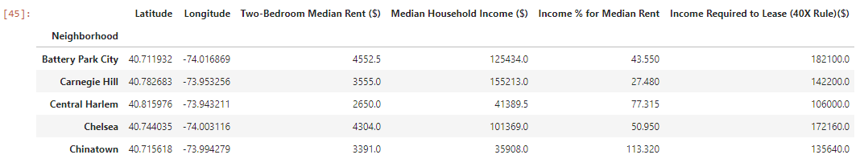
Rent DAta
Manipulate the RentHop New York Two Bedroom Median Rent Affordability
Join this data with the coordinates data (sample below).

Slide 6
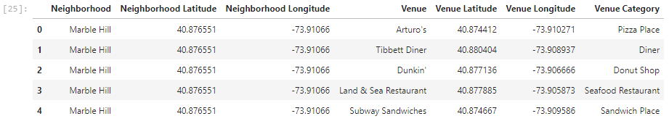
Venue Data
Define Foursquare credentials
Create a function for only extracting food venues from the Foursquare API
Run the function to retrieve the venues into a dataframe (sample shown below)

Slide 7
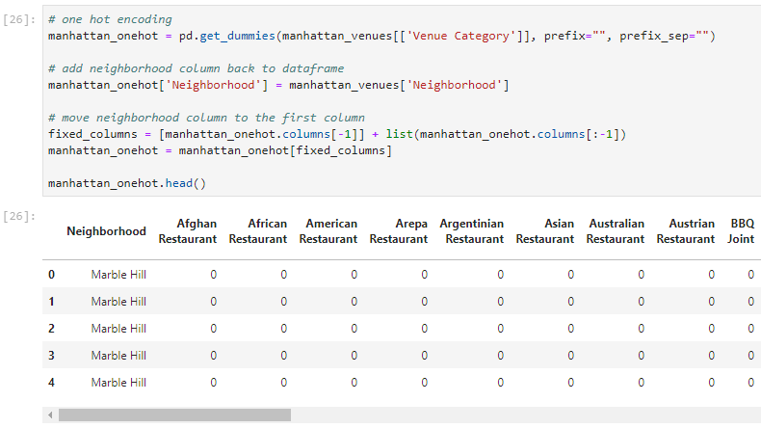
ONE-Hot Encoding
Transform data using the ‘one hot encoding’ function of the ‘pandas’ library

Slide 8
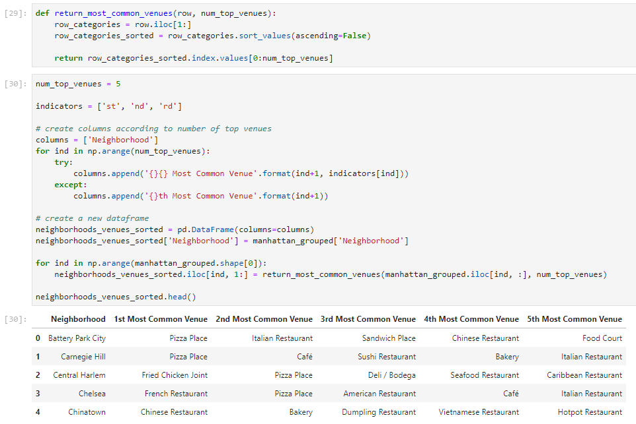
Grouping
Group the dataframe by ‘Neighborhood’
Define a function that returns the most common food venue types (sample below)

Slide 9
Clustering
k-means

Slide 10
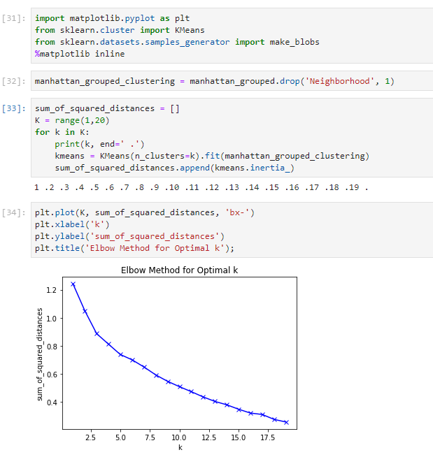
The Elbow Method
Cluster groups for the data using ‘k-means’
Optimal number of clusters (i.e. k)
‘The Elbow Method’
‘The Silhouette Method’
The Elbow Method finds the sum of squared distances of samples to their closest cluster centre for different values of ‘k’
The optimal number of clusters is the value after which there is no significant decrease in the sum of squared distances (at the elbow)
No defined elbow

Slide 11
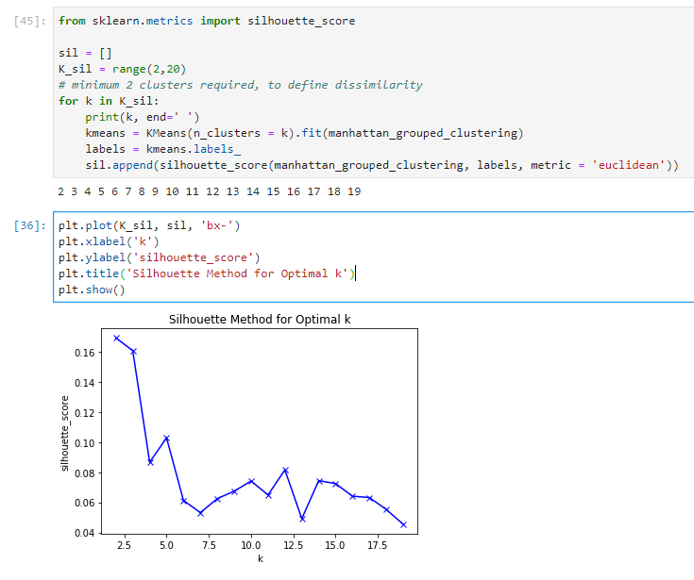
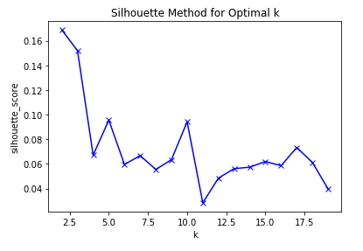
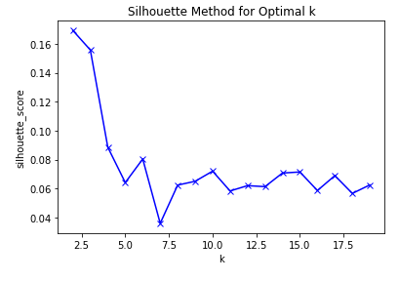
The Silhouette Method
As quoted in Wikipedia — “The Silhouette Method measures how similar a point is to its own cluster (cohesion) compared to other clusters (separation).”
Consistency around 5 and 10
Number of clusters (i.e. ‘k’) chosen was 5.

Slide 12
Results

Slide 13
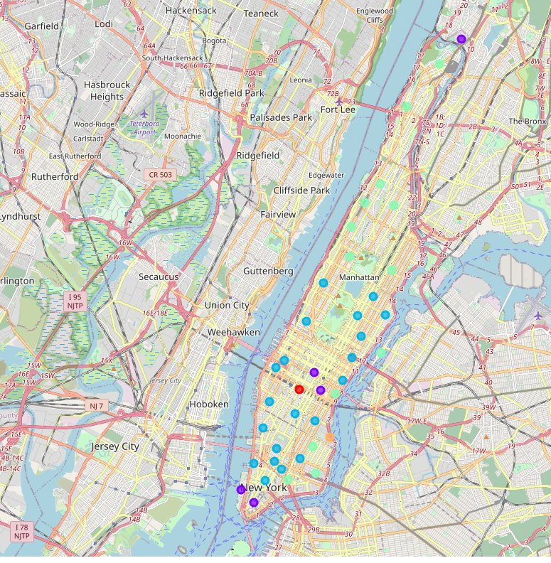
Visualisation
Use Folium package to create map visualisation.
Locations of the neighbourhoods are now clear.

Slide 14
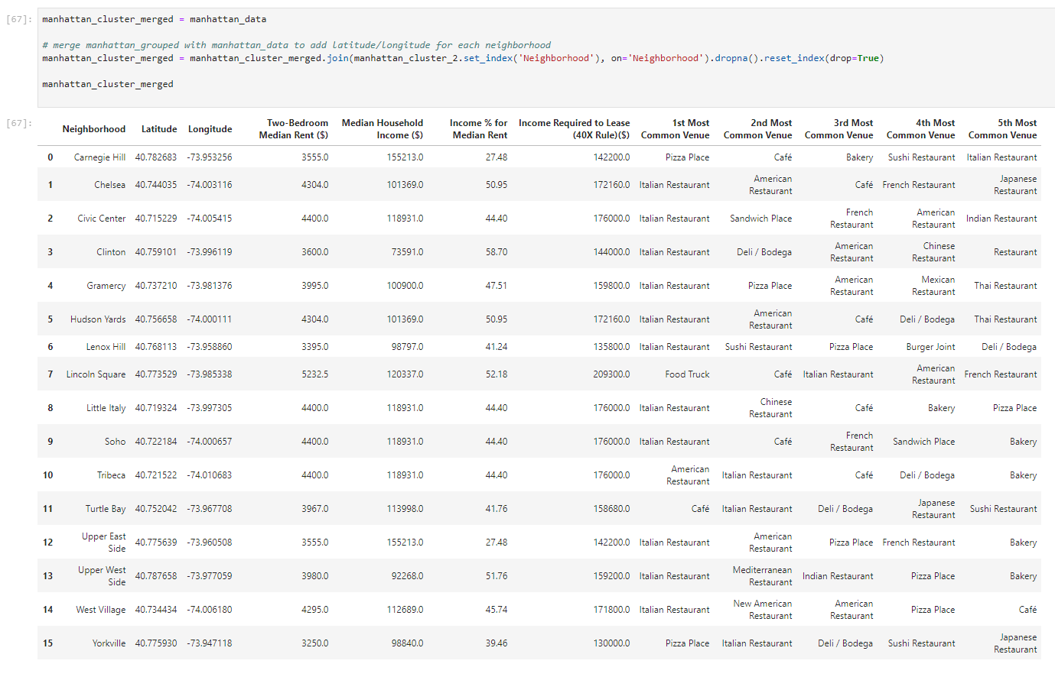
Discussion
Carnegie Hill
“Pizza Place” is the most common food venue
Median Household Income = $1,552,130
Income % for Median Rent = 27.48%
We can assume that Carnegie Hill residents have the most disposable income of all the Manhattan neighbourhoods that like to frequent Pizza places
Best place to open a Pizza place in Manhattan

Slide 15
Conclusion
Used k-means clustering algorithm
Visually explored the location data to find the best neighbourhood to open a pizza place
Did not consider tourist numbers and destinations or neighbourhoods with no rent data (e.g. Financial District etc.)
Focused mainly on the median income and assumed disposable income of the residents of a neighbourhood
Improved this report by investigating more into restaurants in tourist hotspots and looking into the profits of individual restaurants

